Slide 1
Non-classical Secreted Protein Prediction
Supervisor : Dr Matthew Chua
Student: Norvin Chandra – A0195335Y
04 July 2020

Slide 2
Contents
Background
Objectives
Current Model
Initial Technical Approach
Data Acquisition
Data Processing
Initial Modelling
Challenges
Next Step

Slide 3
Background
Bacteria species are commonly classified by their Gram staining which is a method of coloring cells red or violet
Gram-positive bacteria has thick layer of peptidoglycan in cell wall that retains crystal violet
Gram-negative bacteria has thinner peptidoglycan layer that allow crystal violet to wash out on addition of ethanol. This class of bacteria is stained pink or red by counterstain.
This project deals with secretion of protein from gram-positive bacteria through non-classical pathway, i.e. protein secreted by a pathway other than Sec translocon or Tat transporter.
According to Yanju Zhang, et al. in PeNGaRoo paper, “Among all secreted protein, ‘non-classical’ secreted proteins are difficult to identify as they lack discernible signal peptide sequences.”

Slide 4
Objective and Deliverable
To build a classification model to detect non-classical secreted protein from gram-positive bacteria with AUC > 0.85 when tested on the independent test dataset.
Validation will be based on independent test data set provided in PeNGaRoo website

Slide 5
Current BENCHMARK Model
The PeNGaRoo curated own verifiable training and testing dataset on which this project will be based upon
Extract features from 3 different groups: sequence-derived features, evolutionary information based features, physicochemical property based features
Train model on each chosen feature set using Light Gradient Boosting Machine then equal-weight averaging of prediction outputs of feature encoding within same group.
Integrate single machine learning based models into single ensemble model to enhance the prediction performance
Thereafter construct 2 layer LightGBM based ensemble model to take advantage of different feature groups
Instead of merging all features into a higher-dimensional feature set, the team trained base models with each feature sets to learn different useful pattern from various feature sets. When integrating base models, rather than using direct integration which might suffer from information redundancy within same feature group, the team adopted a two-layer ensemble model strategy.

Slide 6
Initial Technical Approach
Use the training dataset constructed by PeNGaRoo team to generate protein features in iFeature web server
Run the training data set on TPOT auto ML to identify potential features and method combination
Select 2 best combination to manually build model and tweak parameters to optimize prediction result
Alternative approach:
Fuse potential features and train on tweaked model
Ensemble models

Slide 7
Data Acquisition
Protein sequence in FASTA format was obtained from http://pengaroo.erc.monash.edu/download.jsp
Data used for this project:
PeNGaRoo_train_N.fasta (negative)
PeNGaRoo_train_P.fasta (positive)
PeNGaRoo_independent_test_N.fasta
PeNGaRoo_independent_test_P.fasta

Slide 8
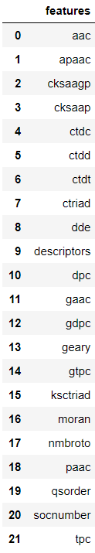
Data Processing
Data processing steps:
Load each train and independent test data to iFeature to obtain protein features for subsequent modelling
Combine respective negative features and positive features to form overall training and independent testing data set
Output of iFeature:
21 pairs of positive and negative training features (“descriptors” is not a feature, it is a file containing all the features)
21 pairs of positive and negative independent test features (“descriptors” is not a feature, it is a file containing all the features)

Slide 9
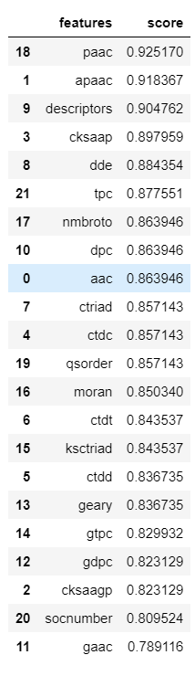
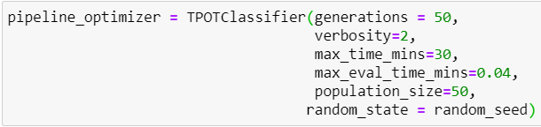
Initial Modelling
Using Python TPOT package to identify potentially best performing features and pipeline combination
1st iteration using the following TPOT configuration:
Result →
Paac on KNN
Apaac on KNN
Cksaap on SGDClassifier
Dde on Gaussian Naive Bayes
Tpc on Bernoulli Naïve Bayes

Slide 10
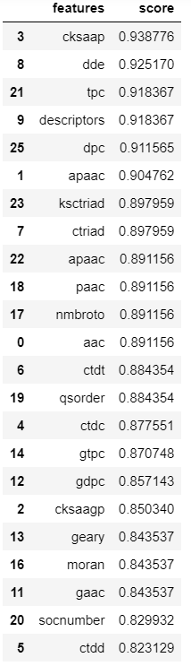
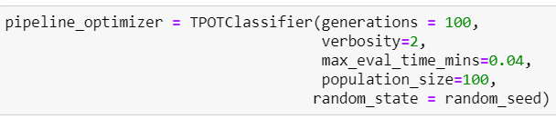
Initial Modelling, cont’d
2nd iteration using the following TPOT configuration:
Took approximately 4 days to run.
Results →
Cksaap on LinearSVC
Dde on KNN
Tpc on LinearSVC
Dpc on MLPClassifier
Apaac on KNN

Slide 11

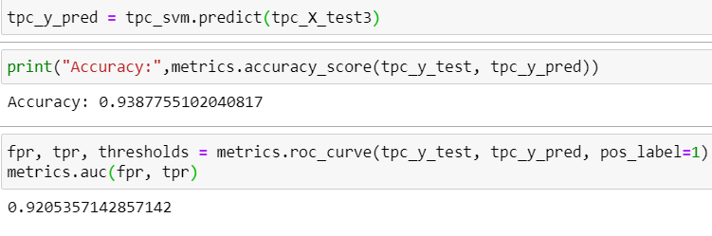

Initial Modelling, cont’d
Attempt 1 – tpc on LinearSVC
Accuracy on validation data set is 93.8% with AUC of 0.92
However when the model is used against independent test data, the accuracy drops to only 50%

Slide 12
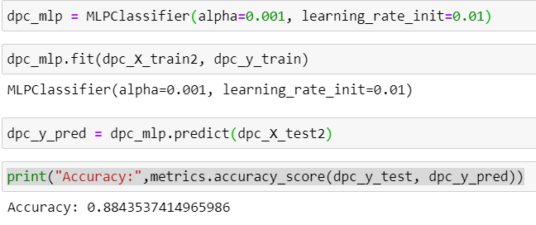
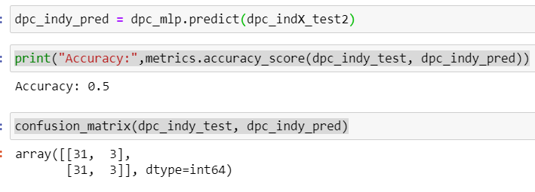
Initial Modelling, cont’d
Attempt 2 – dpc on Multi Layer Perceptron Classifier
Accuracy on validation data set is 88.4% but once tested on independent test data, accuracy drops to 50%

Slide 13
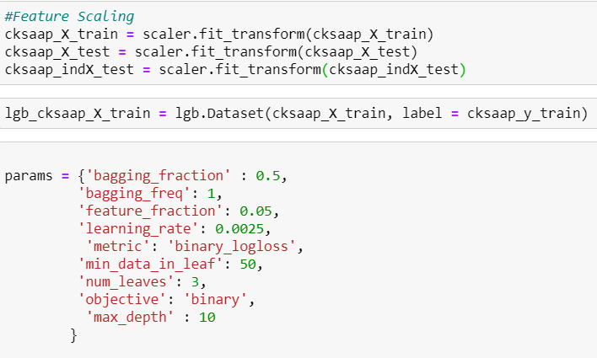
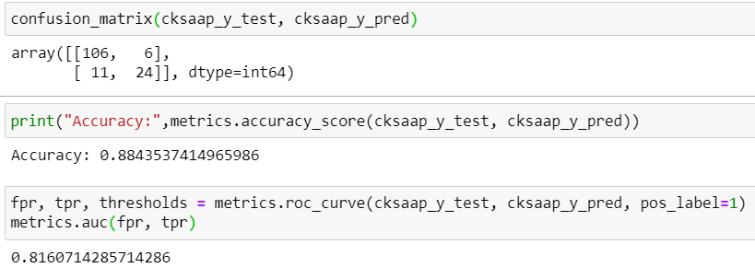
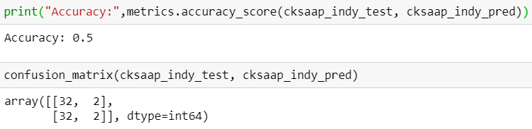
Initial Modelling, cont’d
Attempt 3 – cksaap with LightGBM
Accuracy on validation data set is 88%
Again, when tested on independent test data, accuracy drops to 50%

Slide 14
Challenges
Understanding each feature set is challenging for someone not in the domain
Learning more sophisticated modelling techniques
Attempt to reproduce PeNGaRoo model using original source code (in R) and original data set results in fatal error
Difficulty in finding source code for journals featuring feature fusion
Attempt to find potential pipeline using TPOT takes time. 100 generations with population_size of 100 takes about 4 days to complete
Potential pipeline + feature combinations produce poor accuracy when tested on independent test data set

Slide 15
Next Step
Further reading on sequence-derived features, evolutionary information based features, physicochemical property based features
Further research on other feature transformation / fusion and ensemble modelling technique
Find out reason for the poor performance of current models when tested on independent test set
Guidance on possible methodology and sample codes to reverse engineer solution will be highly appreciated and will greatly assist this project

Slide 16
THANK YOU

